Slide 1
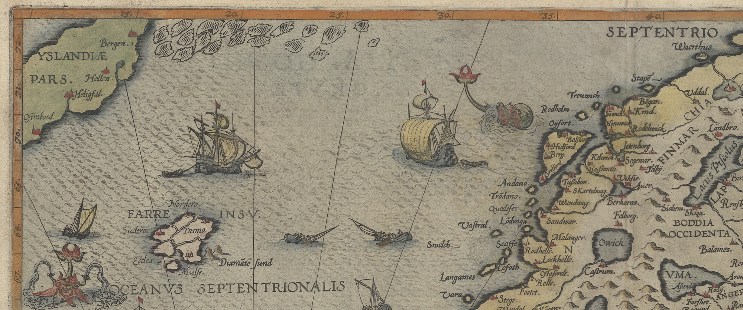
entity-fishing at
Academic Publishing
Aysa Ekanger, University Library of Tromsø
Notes:
Gerard de Jode,
1570,

Slide 2
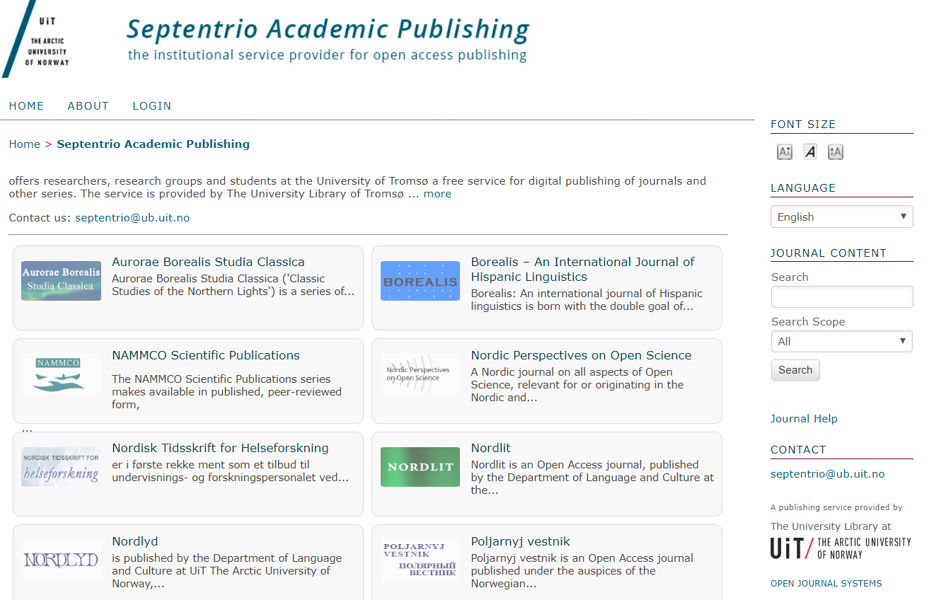
Notes:
Free
8 peer-reviewed journals
7 in DOAJ, 1 in Scopus
7 non-peer-reviewed series
OJS
Organization of the service:
1 FTE (5 people)

Slide 3
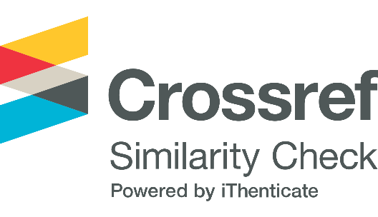
OJS training & support
PKP LOCKSS
XML
Our service portfolio
Help with indexing
Promotion in social media
Article level metrics
entity-fishing
Notes:
It’s a publishing service based at the library, which means that the level of the development is quite basic.
1 FTE – 5 people with no publishing experience – we are self-taught!
No bespoke budget for the service, and we are not aware of the journals’ budgets.

Slide 4
Use cases
PDF annotation
Digitized maps?
Wordclouds
Notes:
Selected publications
Collaboration between Septentrio staff – editor – author
Starting with library’s own, non-peer-reviewed, series

Slide 5
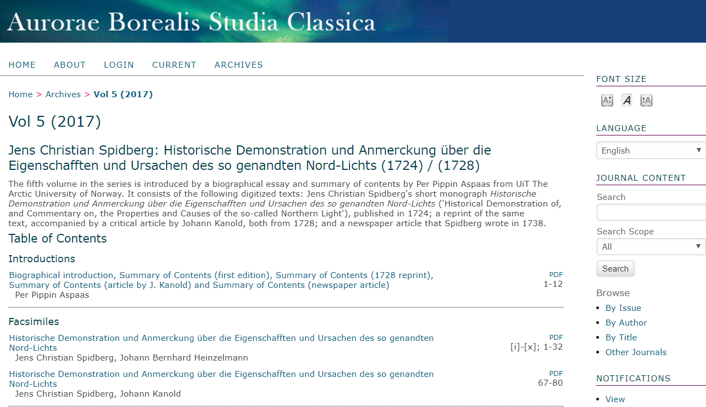
PDF annotation
Notes:
OCR-ed facsimiles and introductions/articles

Slide 6
Archaic place names
https://septentrio.uit.no/index.php/aurora/article/view/4302
Notes:
Gothic script, no authors.
Added value: archaic place names.
New life for digitized books
The entry for Christiania was obtained through term look-up on http://cloud.science-miner.com/nerd/. The PDF disambiguation function didn’t recognize Christiania as a term.

Slide 7
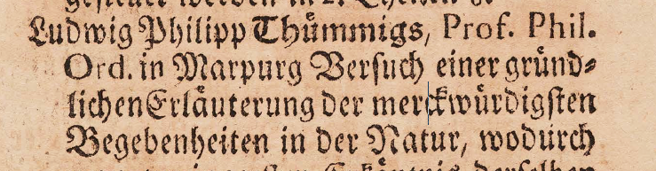
Some issues
Old orthography
1–8% of OCR is wrong
OCR string:
Vei§Ljn!8,8curmjei8, bjerrttinA,
OCR string:
LudwigPhilippThümmigs
Notes:
Train NERD to parse CamelCase?
And how does NERD fare when it comes to incompletely spelled terms: e.g. a character missing or replaced by an alphanumeric character?

Slide 8
Digitized maps
Notes:
1570, Gerard de Jode

Slide 9
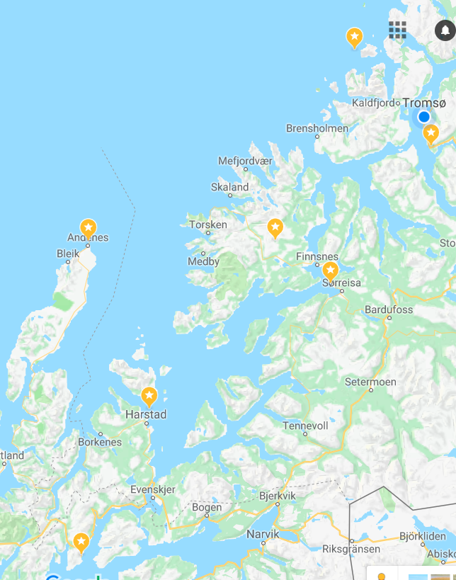
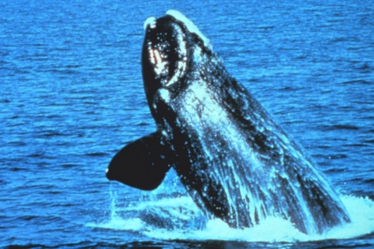
Map-viewing with a responsive modern map-«key»?
Rødholmen
Sandvika
Andenes
Berg
Kjelvika
Trondenes
Septentrionaliu regionum Svetiæ Gothiæ Norvegiæ Daniæ…
Gerard de Jode, 1570
Lødingen
Notes:
Would this be a project for entity-fishing, or will there be too much manual labour involved to motivate use of e-f?
Issues: format of the maps? What kind of programme to use for contemporary maps?
1570, Gerard de Jode
Warping the old map (rubber sheeting it) to fit the modern map would not be interesting. And probably very difficult to do: rubber sheeting is done with maps from the half of the XIX century, which have some accuracy. And I think it’s most interesting how the old maps were «misrepresenting» the geography. But we could go for parallel responsive viewing of the two maps.
Issues with digitized maps may be the format of the maps. They will most probably be in some picture format – does entity-fishing work with pictures or it does not matter?
Gerard de Jode (1509–1591) was a Netherlandish cartographer, engraver and publisher who lived and worked in Antwerp during the 16th century.

Slide 10
PDF annotation in Septentrio’s born-digital series
Septentrio Educational
Concepts and terms
Nordlit
Person names, literary works, works of art
Notes:
Nordlit is published by the Department of Language and Culture

Slide 11
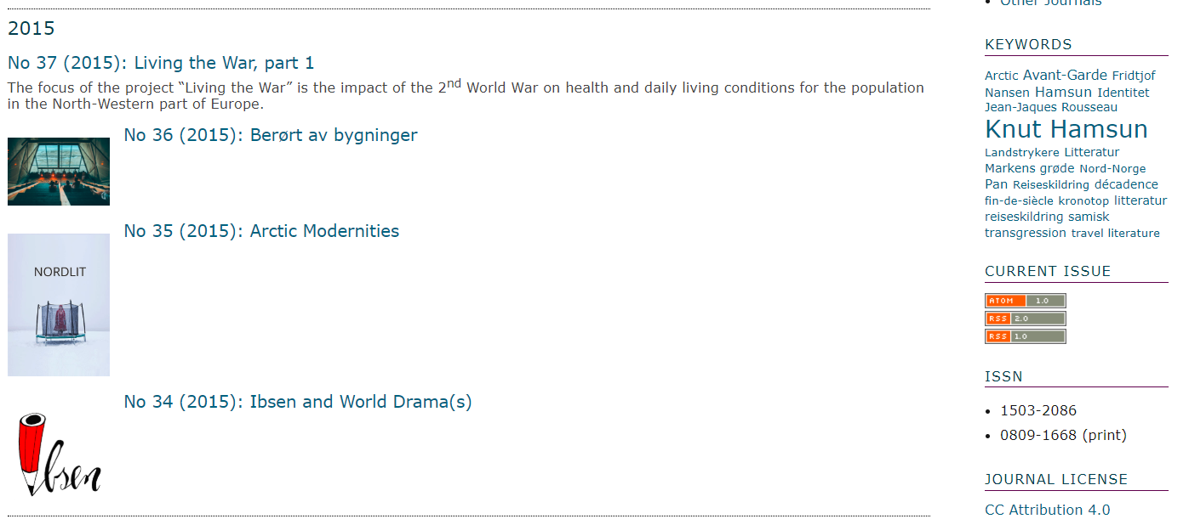
Wordclouds
Notes:
to make entity-fished content visible on the site

Slide 12
The end So, where do we start?

